Slide 1

Lesson 2
Recording Process
(Part 1)

Slide 2

STUDY OBJECTIVES
Accounting Cycle
Definition of Account
Debit and Credit
Rules of Debit and Credit
Books of Prime Entry

Slide 3

STUDY OBJECTIVES
General Ledger
Types of Accounts
Trial Balance

Slide 4
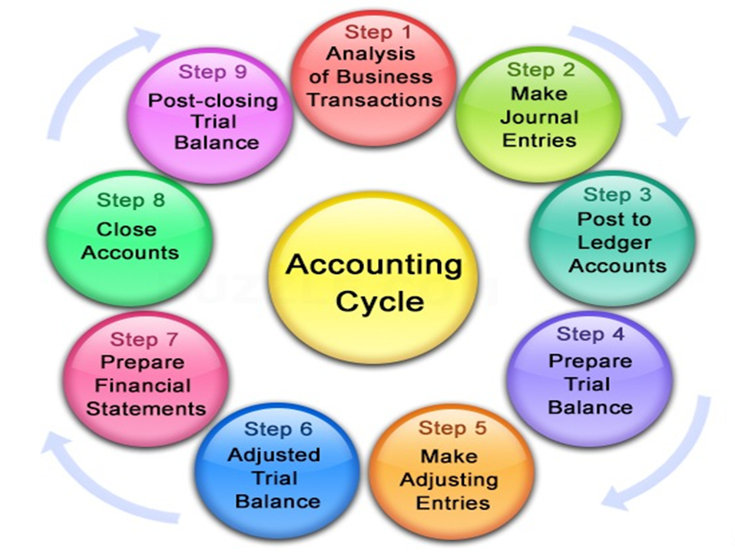

Slide 5

DEFINITION OF ACCOUNT
Individual accounting record
↑ or ↓ in a specific asset, liability or owner’s equity
E.g. Cash, accounts receivable, accounts payable, capital

Slide 6


DEFINITION OF ACCOUNT
Title of Account
Date | Account | Amount (RM) | Date | Account | Amount (RM)
Debit side (Left) Dr. |  |  | Credit side (Right) Cr.

Slide 7
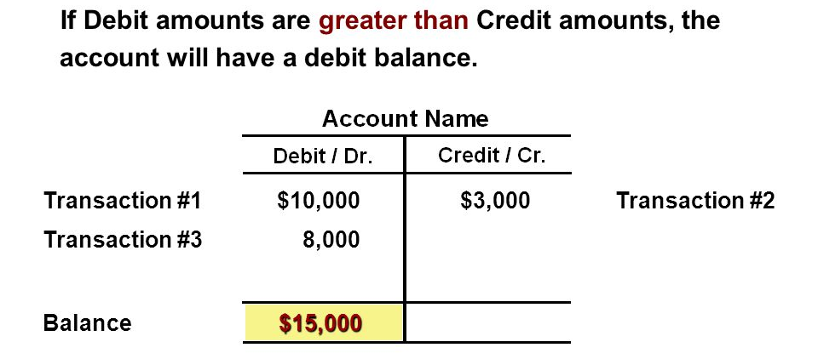
DEBIT AND CREDIT

Slide 8
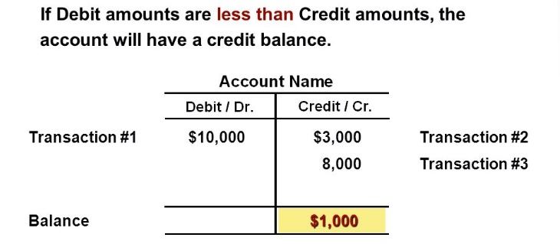
DEBIT AND CREDIT

Slide 9
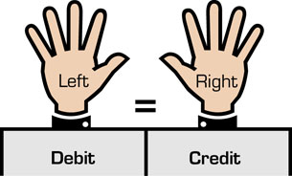
DEBIT AND CREDIT
Double-entry System
Two-sided effect (Duality)
At least involved TWO accounts
Total debits = Total credits
Assets
Liabilities
Equity

Slide 10
RULES OF DOUBLE ENTRY
Assets
Liabilities
Assets a/c
Debit (Increase)
Normal Balance
Credit (Decrease)
Liabilities a/c
Debit (Decrease)
Credit (Increase)
Normal Balance

Slide 11
RULES OF DOUBLE ENTRY
Owner’s equity
Capital a/c
Debit (Decrease)
Credit (Increase)
Normal Balance
Drawing a/c
Debit (Increase)
Normal Balance
Credit (Decrease)

Slide 12
RULES OF DOUBLE ENTRY
Owner’s equity
Revenues
Debit (Decrease)
Credit (Increase)
Normal balance
Expenses
Debit (Increase)
Normal balance
Credit (Decrease)

Slide 13
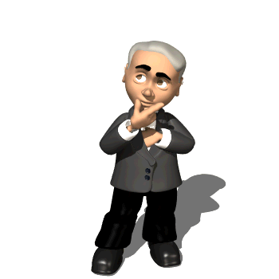
RULES OF DOUBLE ENTRY
Assets
=
Liabilities
+
Owner’s Equity
Owner’s Capital
Owner’s Drawing
Assets
=
Liabilities
+
-
Dr.
Cr.
Dr.
Cr.
Dr.
Cr.
Dr.
Cr.
+ -
- +
- +
+ -
+
Revenues
-
Expenses
Dr.
Cr.
Dr.
Cr.
- +
+ -

Slide 14

The following accounts are applicable to Leona’s Salon, a company that provides manicures and pedicures:
STOP
& APPLY
Cash 5. Accounts payable
Accounts receivable 6. Services revenue
Supplies 7. Wages expense
Furniture 8. Rent expense
For Leona’s Nail Salon, enter the number corresponding to the proper account for each debit and credit for the following transactions:
Debit Credit
Made a rent payment for the current month _______ _______
Received cash from customers for current services _______ ______
Agreed to accept payment next month from
a client for current services _______ _______
d. Purchased supplies on credit _______ _______
e. Purchased a new chair and table for cash _______ _______
f. Made a payment on accounts payable _______ _______

Slide 15

BOOKS OF PRIME ENTRY
Known as “Books of Original Entry”
All transactions are initially recorded
Similar nature & chronological order
Purposes:
Reduce or detect errors
Facilitate posting to ledger

Slide 16

BOOKS OF PRIME ENTRY
Types of journals:
Special journal
Purchase journal
Sales journal
Purchase return journal
Sales return journal
Cash book
Petty cash book
General journal

Slide 17
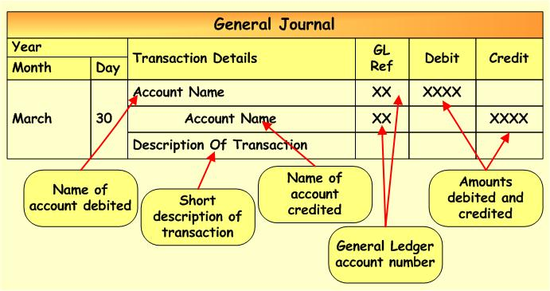
GENERAL JOURNAL
(Optional)

Slide 18
GENERAL JOURNAL
Simple Entry

Slide 19
GENERAL JOURNAL
Compounded Entry

Slide 20
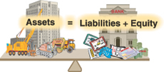
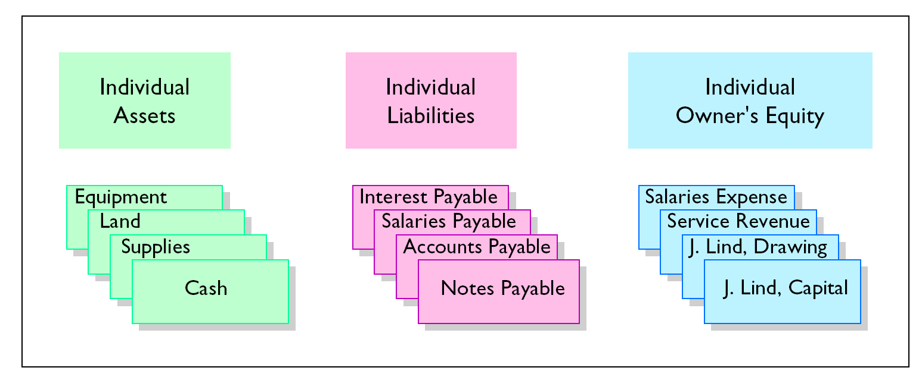
GENERAL LEDGER
A group of T-accounts maintained
Contains all the assets, liabilities and owner’s equity accounts

Slide 21
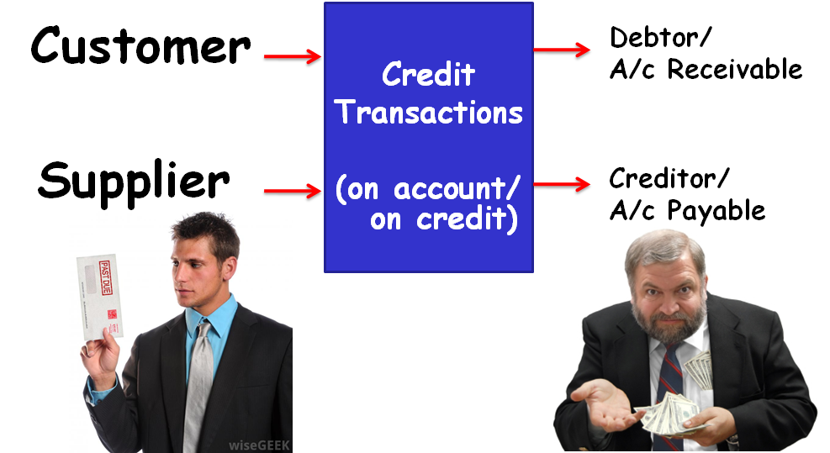
TYPES OF ACCOUNTS

Slide 22
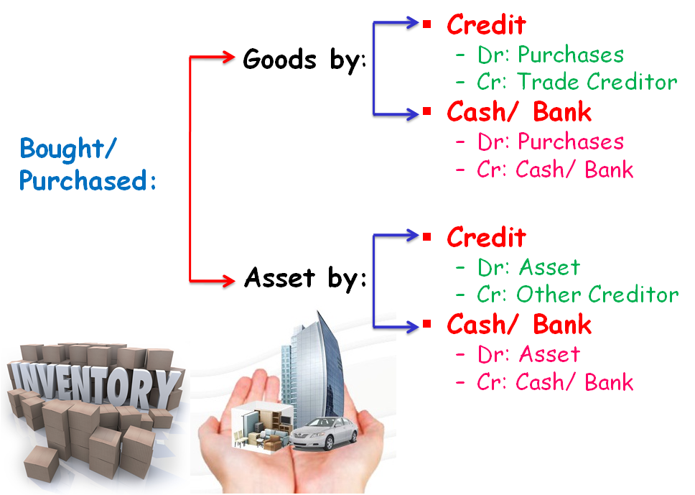
TYPES OF ACCOUNTS
Payables
Payables

Slide 23
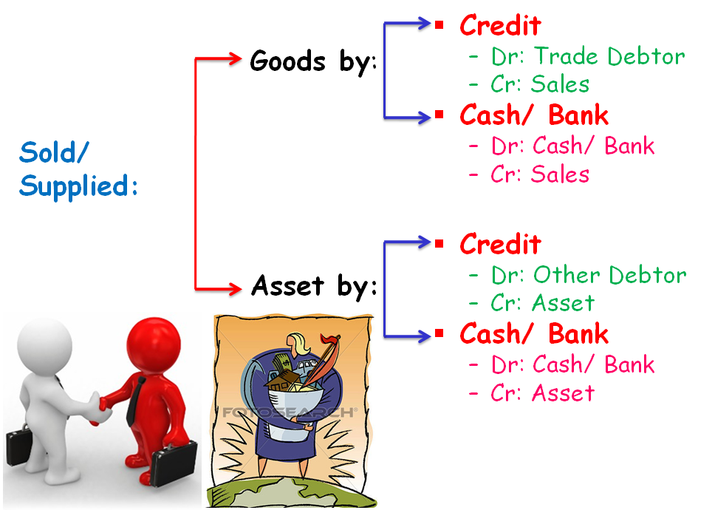
TYPES OF ACCOUNTS
Receivables
Receivables

Slide 24
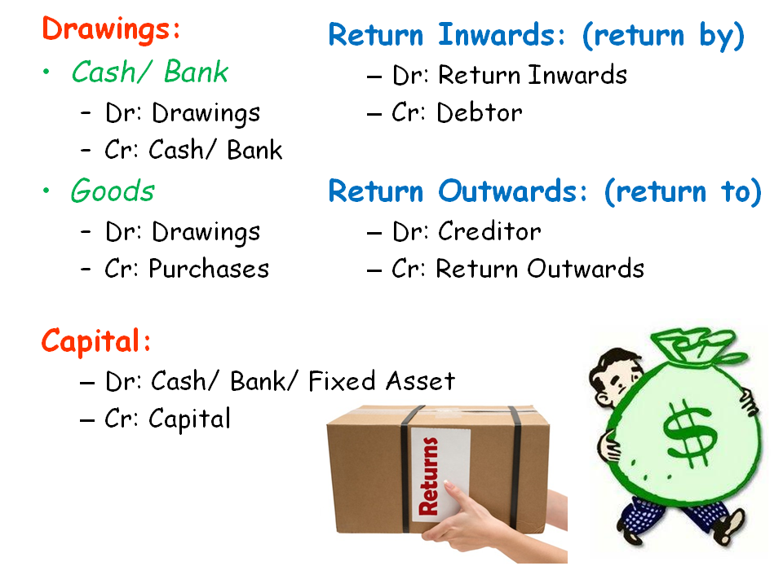
TYPES OF ACCOUNTS
Sales Returns:
Sales returns
Trade Receivables
Purchase Returns:
Trade Payables
Purchase returns

Slide 25
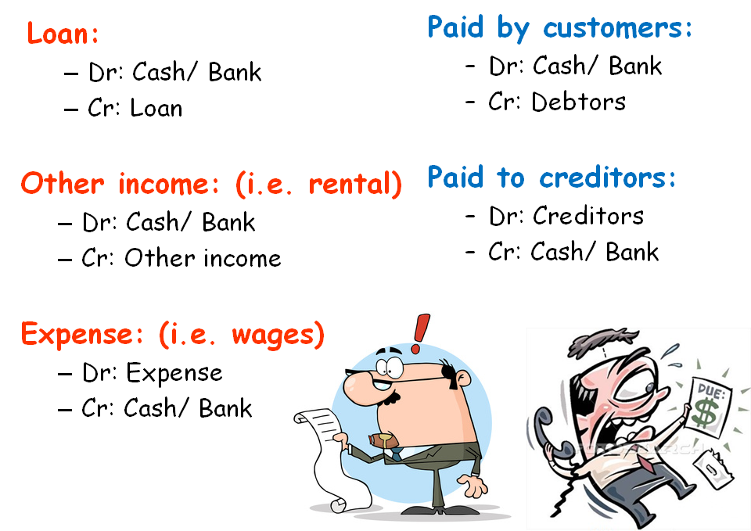
TYPES OF ACCOUNTS
Trade Receivables
Trade Payables

Slide 26
EXAMPLE:
Purchased goods RM 500 on credit from Shafiq.
2. Purchased goods RM 500 on cash from Shafiq.
3. Bought fixtures and fittings RM 1,500 paying by cash from Jati Enterprise.
4. Bought fixtures and fittings RM 1,500 from Jati Enterprise on credit.

Slide 27
EXAMPLE:
Sold goods RM 300 on account to Wafiy.
Sold goods RM 300 on cheque to Wafiy.
Sold van RM 30,000 on credit to Lynn.
Sold van RM 30,000 on cash to Lynn.

Slide 28
EXAMPLE:
The owner took cash for his personal use RM 150.
The owner withdrew RM 200 goods from the business for his personal purpose.
Invested business with RM 900 cash in hand.
Started in business with RM 10,000 cash at bank.

Slide 29
EXAMPLE:
The owner brought office equipment RM 3,500 in the business.
Paid rent by cash RM 200.
Received insurance bill of RM 300.
We received commission from George RM 95 by cash.

Slide 30
EXAMPLE:
Paid Kristina RM 500 by cheque.
Received cash from Daniel RM 1,500.
Returned goods to Kristina RM 25.
Daniel returned goods to us RM 70.

Slide 31

TRIAL BALANCE
List of accounts’ closing balances
To check equality of accounts
Characteristics:
Business name written at top
Closing date after “Trial balance as at …”
Excluded zero balance

Slide 32

TRIAL BALANCE
Steps in preparing:
List all the accounts & its amount (zero balance omitted)
Total up both debit and credit columns
Ensure 2 columns are equal
Check & correct errors if unequal

Slide 33
EXAMPLE:
Cash
2017 |  | RM | 2017 |  | RM
May 1 | Capital | 8,000 | May 10 | Rent | 1,200
5 | Sales | 1,500 | 12 | Stationery | 845
 |  |  | 30 | Wages | 1,360
 |  |  | 31 | Drawings | 710
Capital
 |  |  | 2017 |  | RM
 |  |  | May 1 | Bank | 9,000
 |  |  |  | Cash | 1,000

Slide 34
EXAMPLE:
Purchases
2017 |  | RM
May 2 | C. Vincent | 3,290
6 | R. Wilson | 1,325
C. Vincent
2017 |  | RM | 2017 |  | RM
May 18 | Purchase returns | 1,839 | May 2 | Purchases | 3,290
23 | Bank | 1,451
Instruction: Closing ABC Ltd.'s accounts in above and prepare a trial balance for the month of May 2017.

Slide 35

Lesson 2
Financial Statement
(Part 2)

Slide 36

STUDY OBJECTIVES
Closing the Book
Statement of Profit or Loss
- Purpose & Classification
Statement of Financial Position
- Purpose & Classification

Slide 37
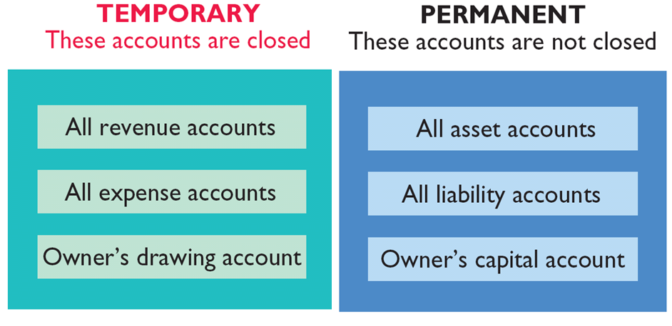
CLOSING THE BOOK

Slide 38
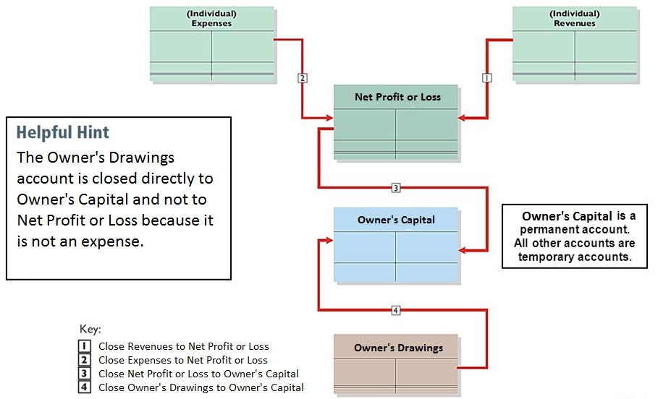
CLOSING THE BOOK

Slide 39
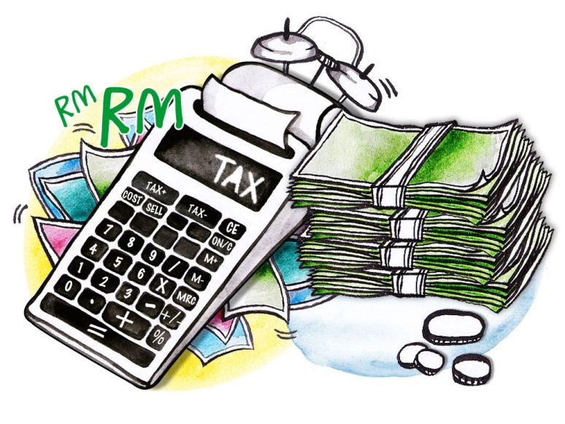
STATEMENT OF PROFIT OR LOSS
Known as “Income Statement”
Summary results of trading activities
Profit or loss during a period
Purpose:
Financial performance
Tax computation

Slide 40

MEASURING PROFIT
Gross Profit
Net Profit/(Loss)
Sales
Gross Profit
MINUS
PLUS
Cost of Goods Sold
Other Income
MINUS
Expenses

Slide 41


CLASSIFICATION
Revenues
Money received by a business
Two sources:
(i) Sales
- Selling goods or services
(ii) Other income
- Interest received
- Discount received
- Commission received

Slide 42
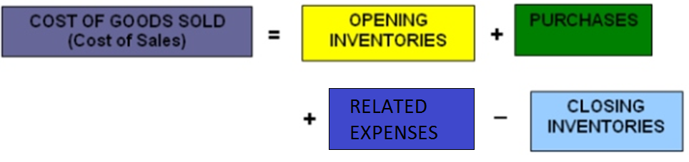

CLASSIFICATION
Cost of Goods Sold (COGS)
Known as “Cost of Sales”
(Net)

Slide 43


CLASSIFICATION
Cost of Goods Sold (COGS)
Related expenses:
Carriage inwards
Import/ custom duties
Insurance on purchases
Costs of packaging

Slide 44



CLASSIFICATION
Expenses
Money spent by a business
Examples:
Salaries and wages
Carriage outwards
Discount allowed

Slide 45
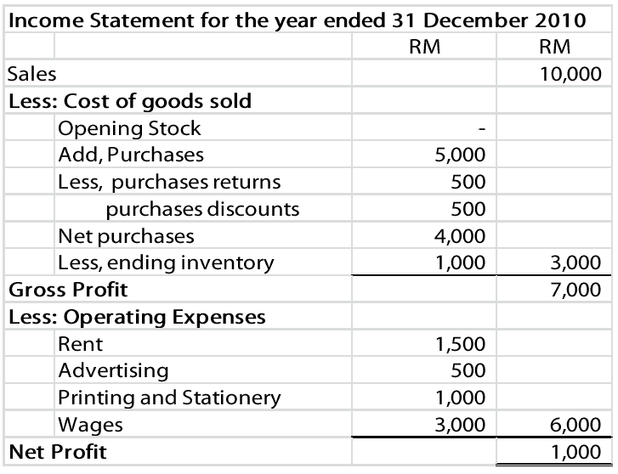

FORMAT - NARRATIVE

Slide 46

STATEMENT OF FINANCIAL POSITION
Known as “Balance Sheet”
List of assets, liabilities and equity
Resources & debts at the end of period
Purpose:
Financial liquidity & stability
Control balance of accounts

Slide 47
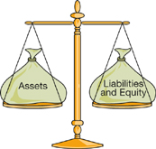

BASIC ACCOUNTING EQUATION

Slide 48

CLASSIFICATION
Contains:
Assets
Non-current assets
Current assets
Liabilities
Non-current liabilities
Current liabilities
Owner’s equity

Slide 49

CLASSIFICATION
Non-current Assets
Not bought for resale
Used in the business operation
Durable goods (more than 1 years)
E.g. Property, plant & equipment, motor vehicles, furniture, fixtures & fittings

Slide 50

CLASSIFICATION
Current Assets
Known as “Liquid assets”
Easy convert to cash
Changes in short-term (within 1 year)
E.g. Cash, bank, inventory/stock, account receivable

Slide 51

CLASSIFICATION
Non-current Liabilities
Long-term debts or obligations
Maturity period (more than 1 years)
E.g. Bank loans, mortgage, hire purchase

Slide 52

CLASSIFICATION
Current Liabilities
Short-term debts or obligations
Maturity period (within 1 year)
E.g. Account payable, bank overdraft, short-term loans

Slide 53

CLASSIFICATION
Owner’s Equity
Amount of money invested by the owner(s)
Owner’s Capital | XX
(-) Owner’s Drawings | (XX)
(+) Net Profit/ (Loss) | XX
Owner’s Equity | XXX

Slide 54
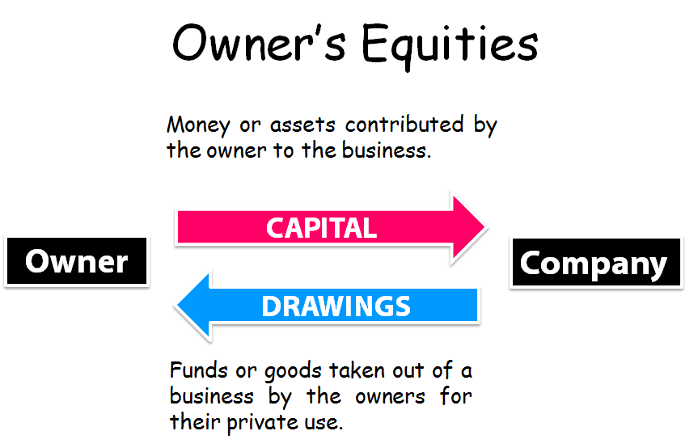



Slide 55
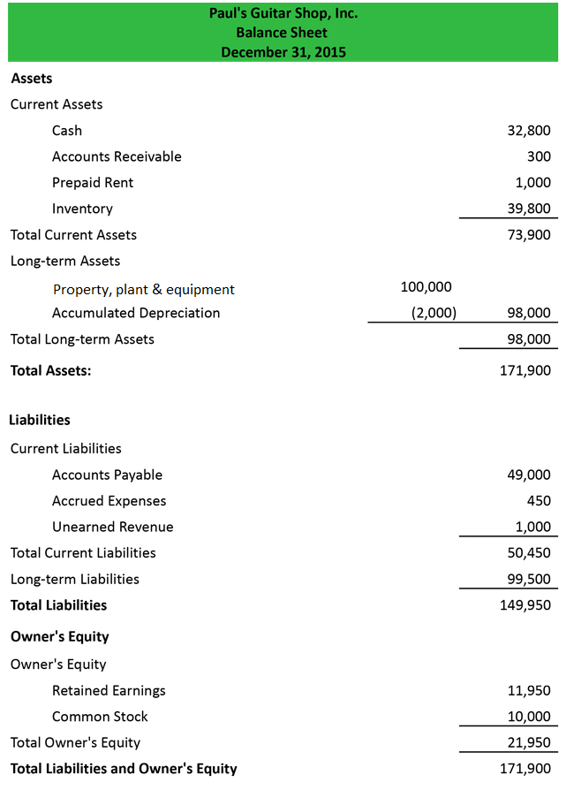

FORMAT - NARRATIVE
Must balance

