Slide 1

Lesson 1
Introduction to Financial Accounting
(Part 1)

Slide 2

STUDY OBJECTIVES
Definition of Accounting
The Accounting Process
Role of Accounting Today
Users of Accounting Information
Management & Financial Accounting

Slide 3

DEFINITION OF ACCOUNTING
Accounting is the process of classifying, recording and summarizing business transactions into monetary units and interpreting the financial data of a business in order to assist stakeholders in making decisions.

Slide 4
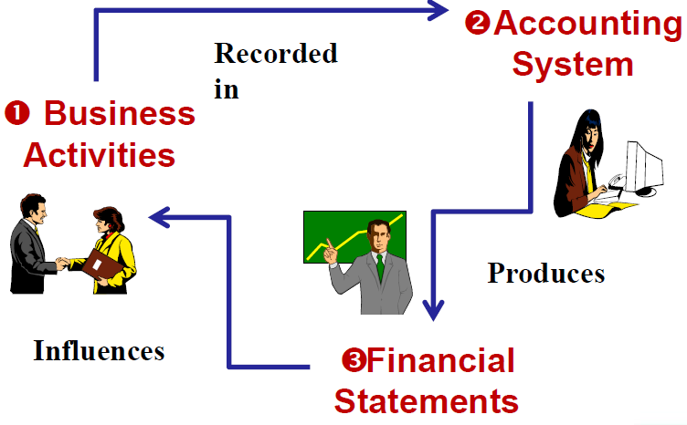
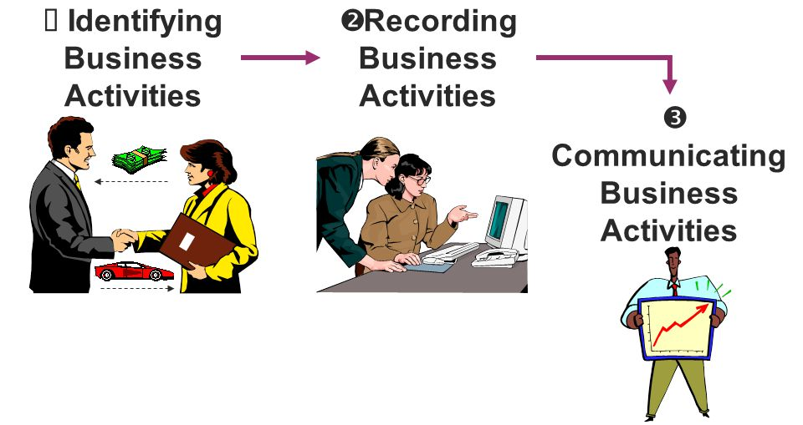

THE ACCOUNTING PROCESS

Slide 5
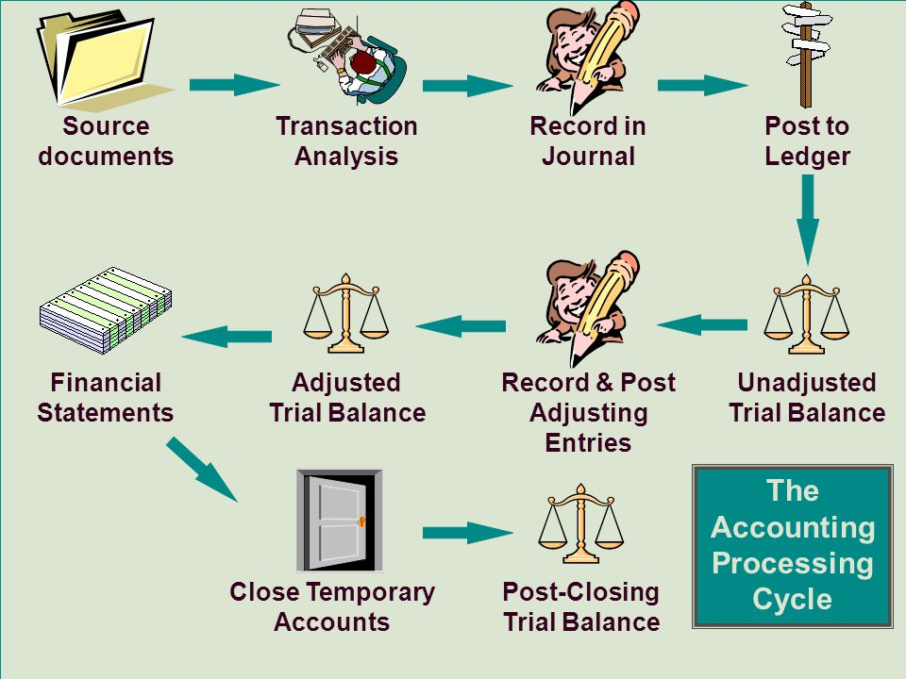
THE ACCOUNTING PROCESS
Notes:
Identification (e.g. Transactions) → Measurement (Quantification in monetary terms) → Recording (Classification and summarization) → Communication (Analysis and interpretation of accounting reports)

Slide 6

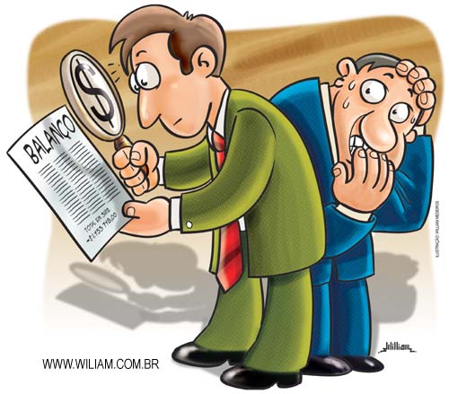
ROLE OF ACCOUNTING TODAY
To maintain accuracy in recording
To prepare financial statements to users
To meet the requirements of the law
To facilitate allocation of resources
E.g. Professional services (Auditing, taxation, management consultancy)

Slide 7
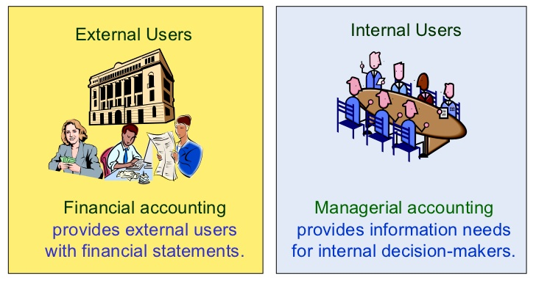
USERS OF ACCOUNTING INFO

Slide 8

Internal Users
Management
  Management uses financial information as a guideline to plan, organize and control the organization and analyze the performance of the business

Slide 9

Internal Users
Finance Department
  Financial information enables the finance department to evaluate the ability of the organization or company to pay its business debts

Slide 10

Internal Users
Marketing Department
  Financial information is used as a guideline to determine the policies and the price of the products to be marketed

Slide 11

Internal Users
Employees
  To assess the ability of the enterprise to provide remuneration, retirement benefits and employment opportunities

Slide 12

Internal Users
Business Owners (Shareholders)
  Business owners need to know the expected rate of return obtained from investments, financial position and the growth rate of the business during a particular period
  Owners use this financial information to make decisions on whether to maintain, increase or stop the investments

Slide 13

EXTERNAL Users
Banks
  Banks need to know the ability of a company or business to repay loans or debts

Slide 14

EXTERNAL Users
Suppliers (Creditors)
  They need to be convinced that the company is able to pay its debt upon maturity

Slide 15

EXTERNAL Users
Trade or Labor Union
  Their concern is to seek a fair wage for their members. Knowing what a company is making will give the employees an insight of what to motivate for as fair wage

Slide 16

EXTERNAL Users
Potential Investors
  Need financial information about the business’s liquidity position and finance, the business’s prospects and ability to generate profit and the ability of the management to handle the business

Slide 17

EXTERNAL Users
Government or Tax Authority
  Inland Revenue Board refers to accounting statements and financial reports in order to determine the amount of tax to be paid

Slide 18

Identify the users as being either external users (E) or internal users (I)
  Customers _________
  Labor unions _________
  Warehouse manager _________
  Production supervisor _________
  Potential investors _________
  Suppliers _________
  Financial institutions _________
  Shareholders _________
  Auditors _________

Slide 19
Match the questions to either external users (E) or internal users (I)
How much profit? __________
Should I invest? __________
What should be produced? __________
Do business have enough cash? __________
What resources are available? __________
Are they acting ethically? __________
How much does it cost? __________
Is the business socially and __________ environmentally friendly?

Slide 20
MANAGEMENT AND FINANCIAL ACCOUNTING
MANAGEMENT ACCOUNTING | FINANCIAL ACCOUNTING
Internal Focus | External Focus
- Planning | Reporting Information
- Controlling | - Performance
- Decision-making | - Position
Cost Behaviour | Financing and Investing
Budgeting | Compliance
Strategy | Highly Regulated

Slide 21

Lesson 1
Recognition, Valuation, Presentation & the Accounting Equation
(Part 2)

Slide 22


STUDY OBJECTIVES
Accounting Elements & Characteristics
      Assets
      Liabilities
      Owner’s equity
Accounting Concepts & Principles

Slide 23


Slide 24

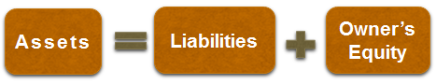
ACCOUNTING ELEMENTS

Slide 25
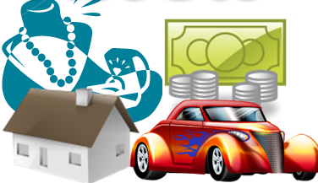
ELEMENTS & CHARACTERISTICS
Assets
Resource controlled
As a result of past events
Future economic benefits are expected to flow to the entity
Something valuable owns or can use

Slide 26
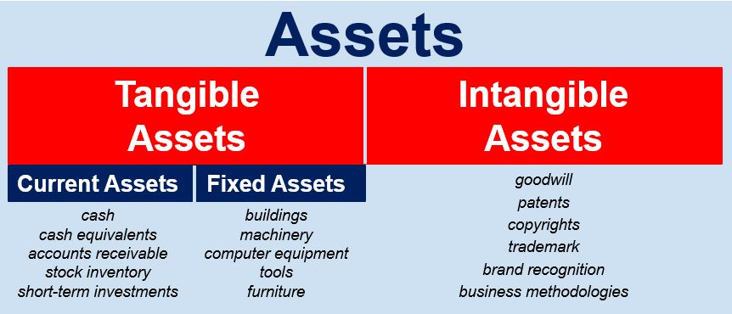



ELEMENTS & CHARACTERISTICS

Slide 27

ELEMENTS & CHARACTERISTICS
Liabilities
Present obligation
Arising from past events
Settlement through transfer of assets are expected an outflow of resources
Something which is owed to someone

Slide 28

ELEMENTS & CHARACTERISTICS
Liabilities
Current
Bank overdraft
Non-current
Mortgage
Accounts payable
Hire purchase

Slide 29

ELEMENTS & CHARACTERISTICS
Owner’s Equity
Residual interest
Owner’s claim on the business
E.g. Capital, drawings, net profit or loss

Slide 30

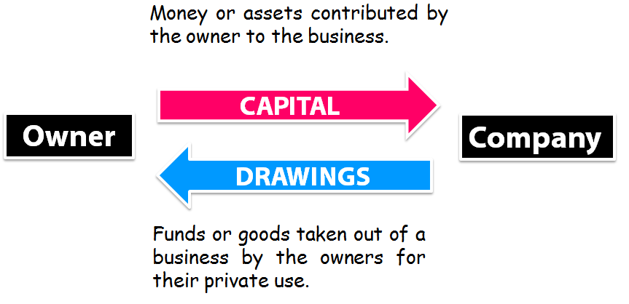

ELEMENTS & CHARACTERISTICS

Slide 31
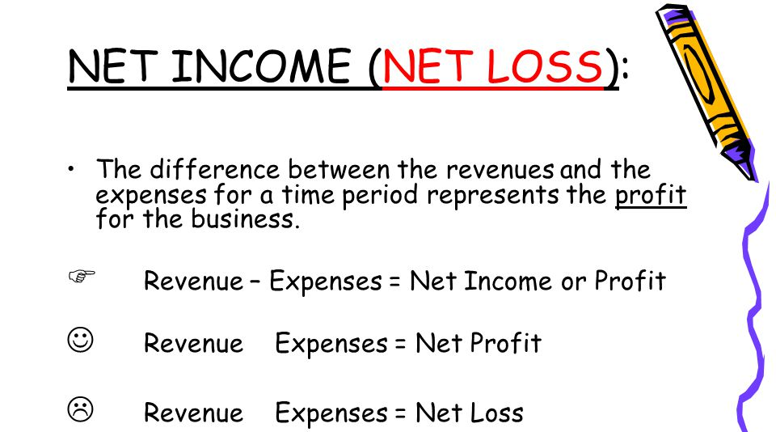

ELEMENTS & CHARACTERISTICS
>
<

Slide 32
Indicate whether each of the following accounts is an current asset (CA), non-current asset (NCA), current liability (CL), non-current liability (NCL), owner’s equity (OE).
Fixtures & fittings |  | Drawings |  | Furniture
Bank overdraft |  | Capital |  | Vehicles
Creditors |  | Loan |  | Cash
Debtors |  | Bank |  | Mortgage
Inventory |  | Machine |  | Premises
Office equipment |  | Delivery van |  | Land

Slide 33
Indicate whether each of the following accounts is expenses (E) or revenue (R).
Advertisement |  | Salesman Commission |  | Legal Fees
Wages & Salaries |  | Discount Allowed |  | Bad Debts
Commission Received |  | Insurance |  | Repair & Maintenance
Discount Received |  | Loan interest |  | Utility
Carriage Outwards |  | Stationery |  | Rental paid
Promotion |  | Electricity |  | Rental received

Slide 34
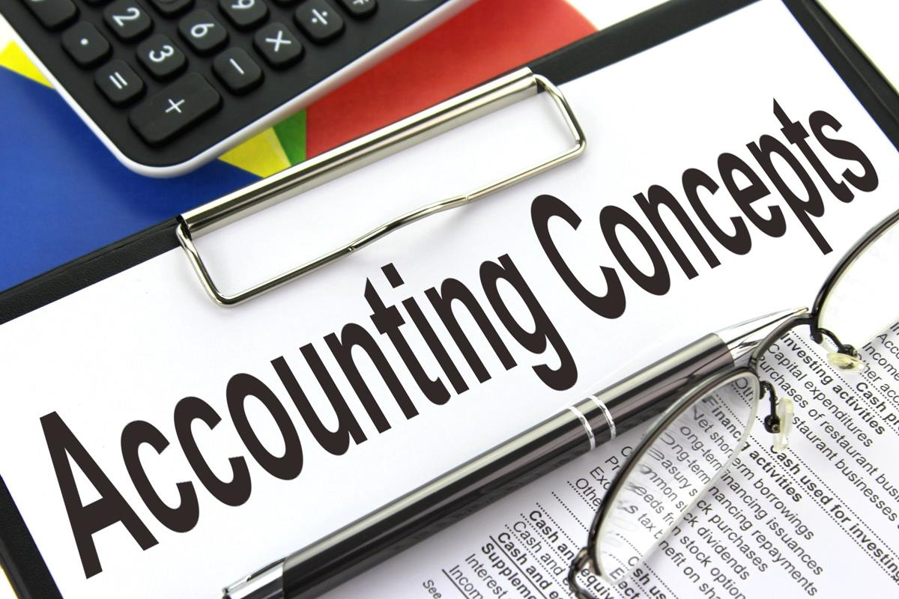

Slide 35
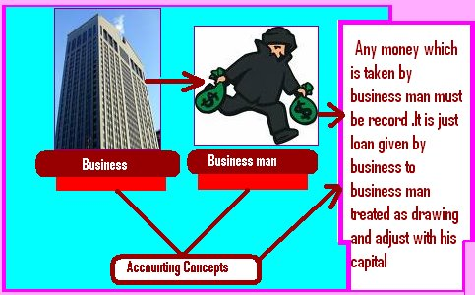
CONCEPTS & PRINCIPLES
Separate/ Business Entity
Clear distinction between business & owners’ activities to reflect true financial condition of the business

Slide 36


CONCEPTS & PRINCIPLES
Going Concern
Continue to operate for a foreseeable future
Users predict future activity of business
Value of assets shown as historical cost and NOT the scrap value

Slide 37

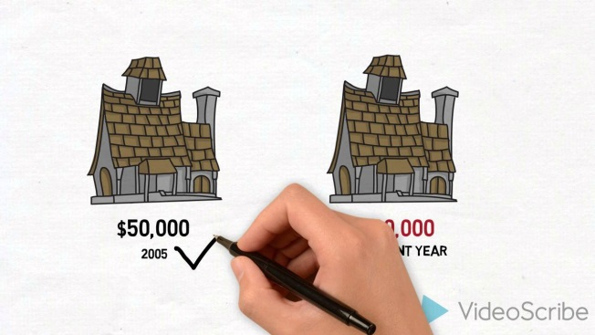
CONCEPTS & PRINCIPLES
Historical Cost (Cost Principle)
Non-current assets are recorded at their original/ acquisition value
Based on going concern assumption (NOT likely to be liquidated or bankruptcy)
In subsequent periods revalued at market price (appreciation or depreciation)

Slide 38


CONCEPTS & PRINCIPLES
Time Period Concept
Business life divided into an interval period
Particular periods of time (e.g. yearly, quarterly, half-yearly)
Purposes:
      Preparation financial statements
      Comparability performance & position

Slide 39


CONCEPTS & PRINCIPLES
Monetary Unit Assumption
Transactions must be quantified or expressed in terms of money
Common monetary value (e.g. Ringgit in Malaysia)

Slide 40
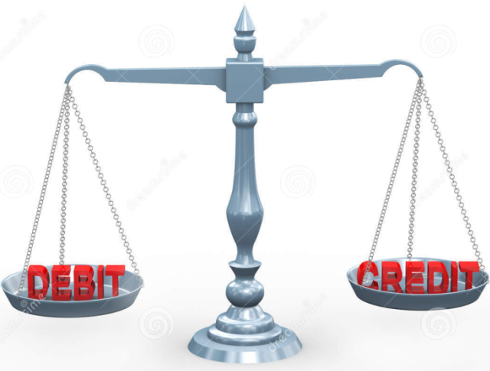
CONCEPTS & PRINCIPLES
Duality
Double-entry system (debit & credit)
Twofold aspect of each transaction affect business in two different ways
Example: Paid a salary by cash
Increase in expenses (Debit=Salary)
Decrease in assets (Credit=Cash)

Slide 41



CONCEPTS & PRINCIPLES
Accrual Concept
Revenue recognized when earned:
Goods are sold & delivered
Services are performed
Expenses recognized when incurred:
Costs consumed to produce revenue

Slide 42
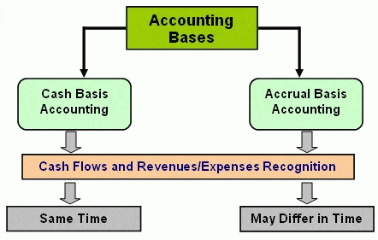


Slide 43


CONCEPTS & PRINCIPLES
Realization Concept
Revenue recognition principle
Revenue is recognized when earned irrespective money received
At the point of sale/ transfer of legal ownership
Goods are delivered & accepted
Services are performed
E.g. Automobile industry

Slide 44

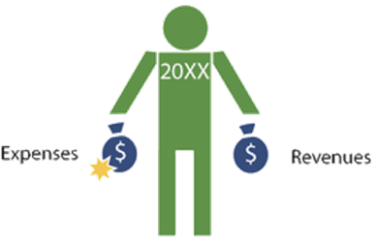
CONCEPTS & PRINCIPLES
Matching Concept
Expenses incurred match with revenues earned to determine profit during a specified time interval
Prepaid expenses and unearned revenues does not recognized

Slide 45

CONCEPTS & PRINCIPLES
Full Disclosure Principle
Fully disclosed any circumstances and events that create significant effects on financial status
E.g. Pending lawsuits, joint venture
Notes to accounts:
➔ Summary of accounting policies
➔ Inventory control methods & depreciation policies of fixed assets

Slide 46

CONCEPTS & PRINCIPLES
Consistency
Same accounting policy and methods over certain period of time (e.g. Depreciation)
Any differences must be disclosed and justified in notes to accounts
Purposes:
      Prevent misleading profit
      Periodical comparison

Slide 47

CONCEPTS & PRINCIPLES
Materiality
Impact of a transaction (nature and amount) on a firm’s overall financial condition
Material ➔ Likely influence decision of users
Immaterial ➔ Inclusion or omission has no impact
E.g. Purchase of low cost fixed assets can be treated as expense

Slide 48
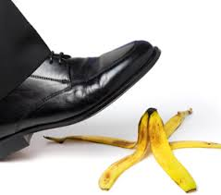

CONCEPTS & PRINCIPLES
Prudence (Conservatism)
NOT overstated assets and profits
NOT understated expenses and losses
Recorded foreseeable losses BUT profit will only recorded when realized
E.g. Closing stock (lower of cost or market value)
Notes:
Anticipate no profit, but provide for all possible losses

