Slide 1


Introduction to database
Lecture 1

Slide 2

OBJECTIVES
Some common uses of database systems.
Characteristics of file-based systems.
Problems with file-based approach.
Meaning of the term database.
Meaning of the term Database Management System (DBMS). Typical functions of a DBMS.
Major components of the DBMS environment.
Personnel involved in the DBMS environment.
History of the development of DBMSs.
Advantages and disadvantages of DBMSs.

Slide 3
Examples of Database Application System
Purchases from the supermarket
Purchases using your credit card
Booking a holiday at the travel agents
Using the local library
Taking out insurance
Renting a video
Using the Internet
Studying at university

Slide 4

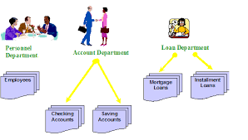
File Based System
Collection of application programs that perform services for the end users (e.g. reports).
Each program defines and manages its own data.

Slide 5
File Based Processing

Slide 6
Limitations of File Base Processing
Separation and isolation of data
  Each program maintains its own set of data.
  Users of one program may be unaware of potentially useful data held by other programs.
Duplication of data
  Same data is held by different programs.
  Wasted space and potentially different values and/or different formats for the same item.

Slide 7
Limitations of File Based Processing
Data dependence
  File structure is defined in the program code.
Incompatible file formats
  Programs are written in different languages, and so cannot easily access each other’s files.
Fixed Queries/Proliferation of application programs
  Programs are written to satisfy particular functions.
  Any new requirement needs a new program.

Slide 8
Database Approach
Arose because:
  Definition of data was embedded in application programs, rather than being stored separately and independently.
  No control over access and manipulation of data beyond that imposed by application programs.
Result:
  the database and Database Management System (DBMS).

Slide 9
Database
Shared collection of logically related data (and a description of this data), designed to meet the information needs of an organization.
System catalog (metadata) provides description of data to enable program–data independence.
Logically related data comprises entities, attributes, and relationships of an organization’s information.

Slide 10
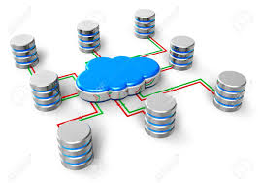
Database Management System (DBMS)
A software system that enables users to define, create, maintain, and control access to the database.
(Database) application program: a computer program that interacts with database by issuing an appropriate request (SQL statement) to the DBMS.

Slide 11
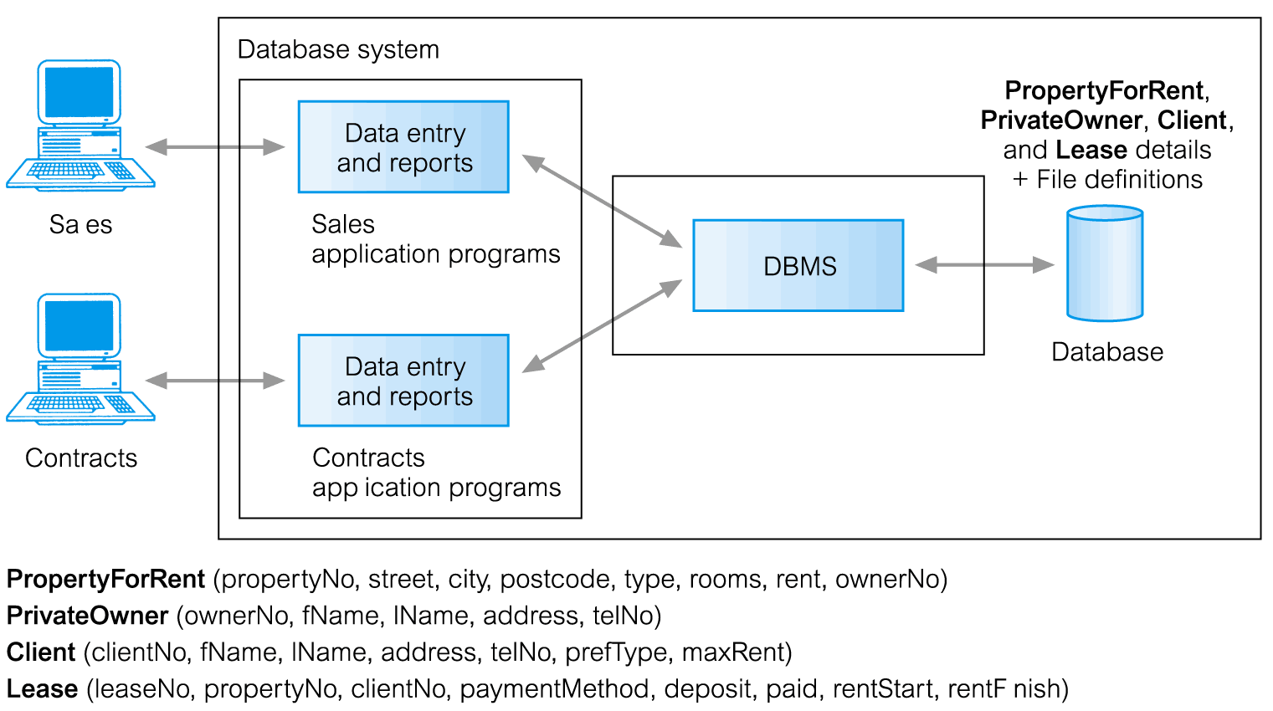
Database Management System (DBMS)
Pearson Education © 2014

Slide 12
Database Approach
Data definition language (DDL).
  Permits specification of data types, structures and any data constraints.
  All specifications are stored in the database.
Data manipulation language (DML).
  General enquiry facility (query language) of the data.
Controlled access to database may include:
  a security system
  an integrity system
  a concurrency control system
  a recovery control system
  a user-accessible catalog.

Slide 13
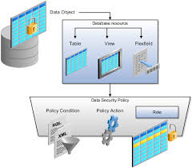
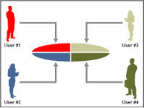
Views
Allows each user to have his or her own view of the database.
A view is essentially some subset of the database.

Slide 14
Views - Benefits
Reduce complexity
Provide a level of security
Provide a mechanism to customize the appearance of the database
Present a consistent, unchanging picture of the structure of the database, even if the underlying database is changed

Slide 15
Components of DBMS

Slide 16
Components of DBMS
Hardware
  Can range from a PC to a network of computers.
Software
  DBMS, operating system, network software (if necessary) and also the application programs.
Data
  Used by the organization and a description of this data called the schema.
Procedures
  Instructions and rules that should be applied to the design and use of the database and DBMS.
People

Slide 17
Roles in DBMS
Data Administrator (DA)
Database Administrator (DBA)
Database Designers (Logical and Physical)
Application Programmers
End Users (naive and sophisticated)

Slide 18
History of Database System
First-generation
  Hierarchical and Network
Second generation
  Relational
Third generation
  Object-Relational
  Object-Oriented

Slide 19
Advantages of DBMS
Control of data redundancy
Data consistency
More information from the same amount of data
Sharing of data
Improved data integrity
Improved security
Enforcement of standards
Economy of scale
Balance conflicting requirements
Improved data accessibility and responsiveness
Increased productivity
Improved maintenance through data independence
Increased concurrency
Improved backup and recovery services

Slide 20

Disadvantages
Complexity
Size
Cost of DBMS
Additional hardware costs
Cost of conversion
Performance
Higher impact of a failure

Slide 21
Exercise
Discuss the roles of the following personnel in the
database environment:
  Data Administrator
  Database Administrator
  Logical Database Designer
  Physical Database Designer
  Application Developer
  End Users

